Slide 1

Text Classification of Medical Device Recalls
By: Ruth Iang
DATA 606
Fall 2023

Slide 2
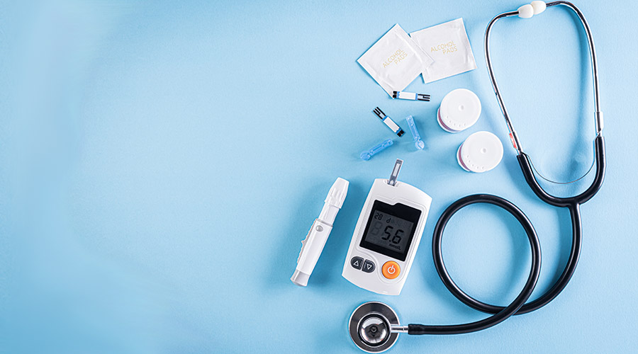
Introduction
Medical device are recalled by FDA to protect the public from potential risks of injury
Classified into 3 classes
Class I-Most severe,
Class II-Moderate,
Class III- negligible harm
From year 2012-October 2023

Slide 3

Data Cleaning/ Normalization
Kept only relevant columns, Event Classification and Reason for Recall
Dropped nulls and duplicates
Made all letters/words lowercase
Tokenized feature variable
Stop words removal
Print the stem of the text in the feature variable
Notes:
-This helps improve model performance by reducing dimensionality and ensuring similar words are treated the same way, enhancing the effectiveness of natural language processing task.

Slide 4
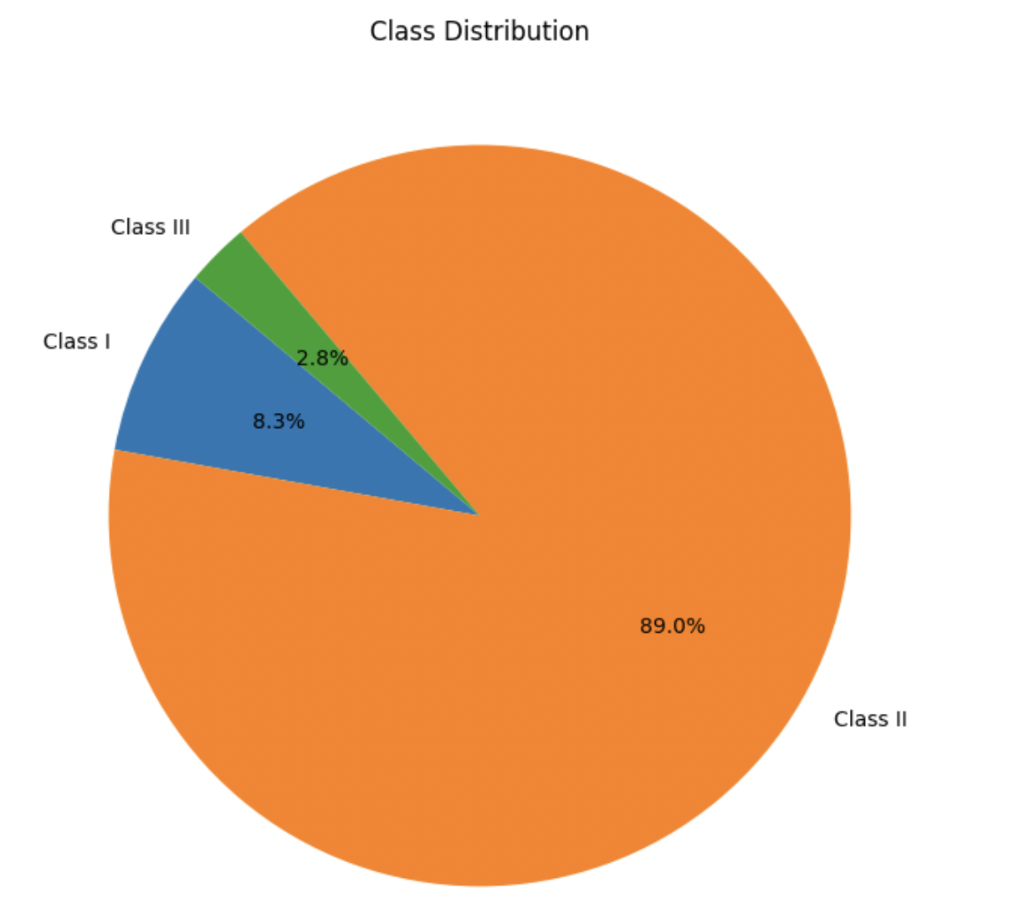
Distribution of classes
Heavily Imbalanced dataset
Class II makes up majority of data
Class III and I are minority classes

Slide 5
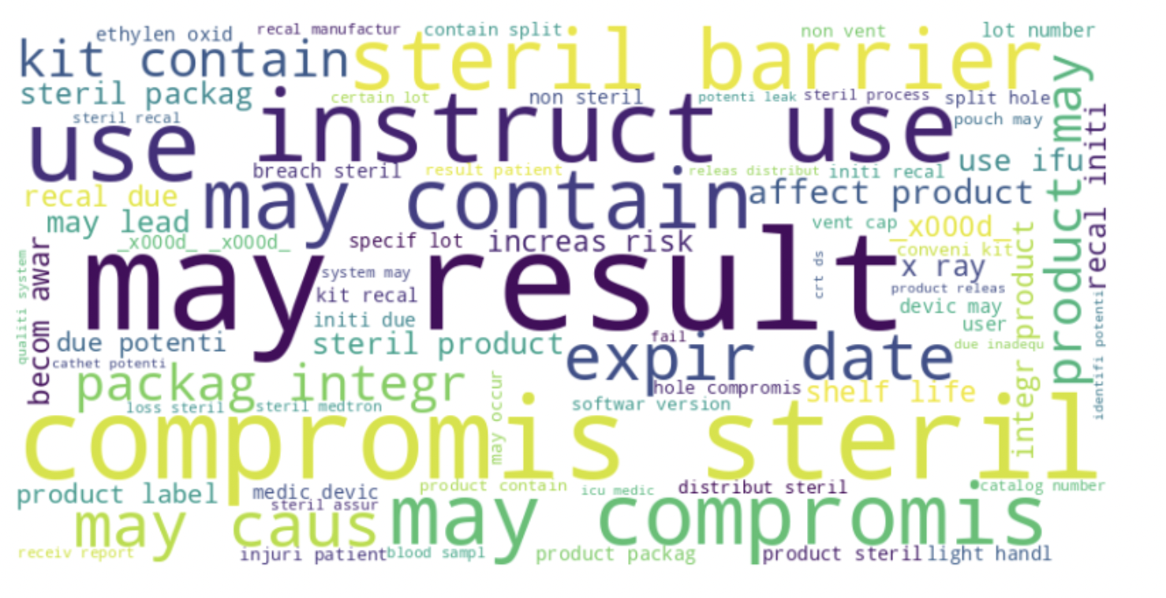
Word Cloud
Bilinear- visualize two words and their importance with each other in a single layout
Font size shows frequency of words in dataset
Shows main idea of dataset

Slide 6

Data Preprocessing
Used TF-IDF Vectorizer to transform feature variable into numerical column
Used SMOTE (Synthetic Minority Over-sampling Technique)
to treat imbalanced distribution
to increase minority class
Split 80% of data to training, and 20% to test

Slide 7
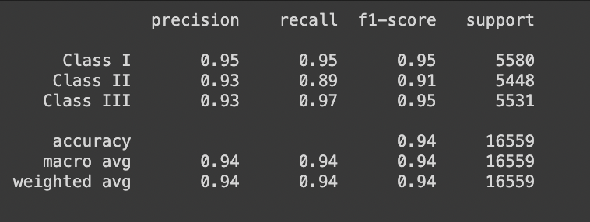
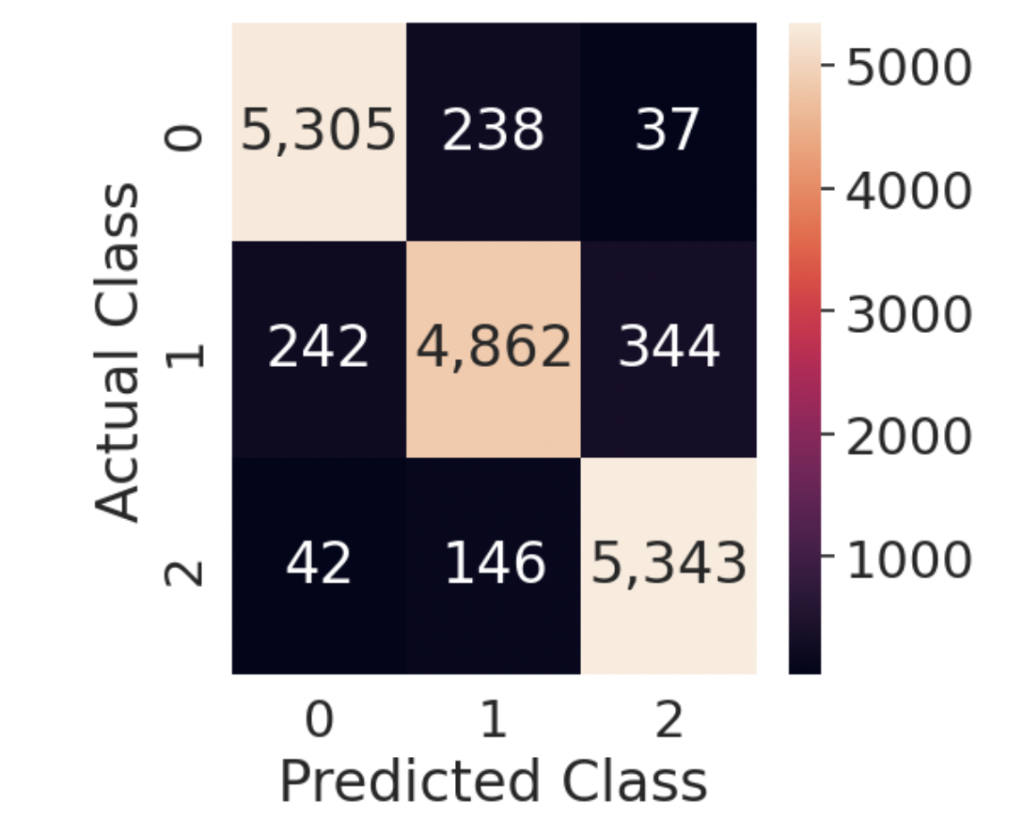
Multinomial Naïve bayes
Classification Report
Confusion Matrix Heatmap

Slide 8

Multinomial Naïve bayes
Accuracy: .9366
Precision: 0.937
F1 Score: 0.936
Recall: 0.937
Hyperparameter Tuning:
Used Grid Search CV and alpha values for best parameter
The best parameter was alpha is 0.1, and accuracy is .954

Slide 9
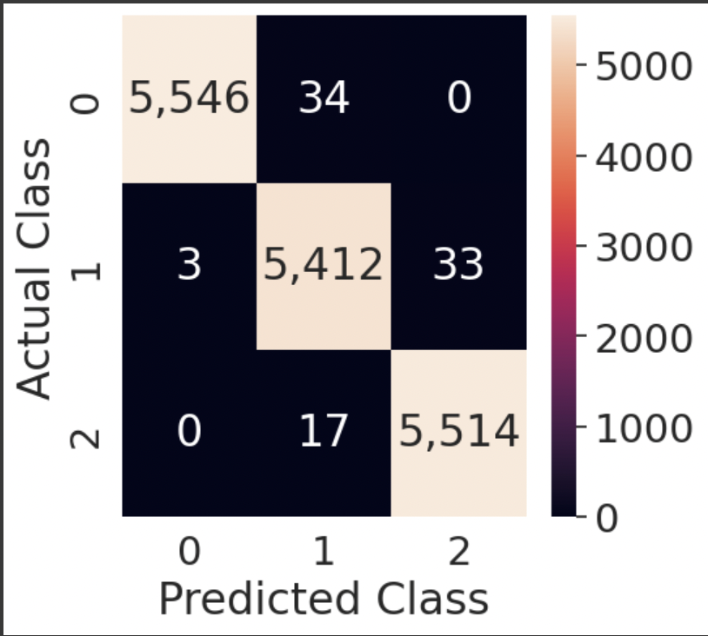
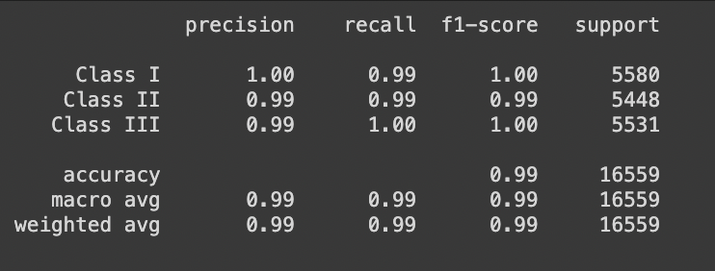
Random Forest Classifier
Confusion Matrix Heatmap
Classification Report

Slide 10
Random Forest Classifier
Accuracy 0.995
Precision: 0.937
F1 Score: 0.995
Recall: 0.995
Hyperparameter Tuning:
Used Randomized Search and cross validation to find the best parameters
Best Parameters: n_estimators: 100, min_samples_split: 5, min_samples_leaf: 1, max_depth: None
Accuracy: 0.995

Slide 11
LSTM Model
Accuracy .929
num_epochs = 10
batch_size = 32
Validation Loss: 0.248
Validation Accuracy: 0.928

Slide 12
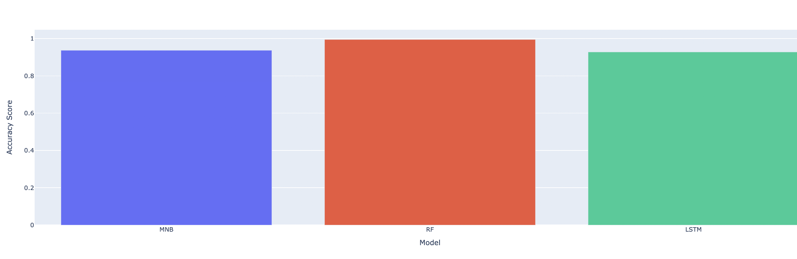
Models Accuracy Bar Chart
-The height of the charts aren’t obvious, but Random forest model has the highest accuracy score.

Slide 13
Conclusion
Random Forest performed the best with accuracy of .995
Cross Validation and SMOTE- prevent overfitting
The Random Forest classifier- reliable to classify FDA medical device recalls, ensuring faster processing and consistently accurate results.

